Slide 1
Introduction to CSS
Notes:
1

Slide 2
What is CSS
Creative control over the layout and design of your web page.
CSS works with HTML but is NOT HTML.
CSS works with the web browser to make HTML look good
Arrange images, create columns and banners, highlight text, etc…
CSS is all about changing and improving the appearance of HTML
Notes:
2

Slide 3
How To Insert CSS
There are basically 3 ways to insert CSS
External style sheet
Internal style sheet
Inline style
We will be focusing on external style sheets.
Notes:
3

Slide 4
Understanding CSS
The key to understanding how CSS works is to imagine that there is an invisible box around every HTML element.
CSS allows you to create rules that control the way that each individual box (and the contents of that box) is presented
In the example on the next slide, block level elements are shown with red borders, and inline elements have green borders.
The <body> element creates the first box, then the <h1>, <h2>, <p>, <i>, and <a> elements each create their own boxes within it.
Using CSS, you could add a border around any of the boxes, specify its width and height, or add a background color.
You could also control text inside a box — for example, its color, size, and the typeface used.
Notes:
4

Slide 5
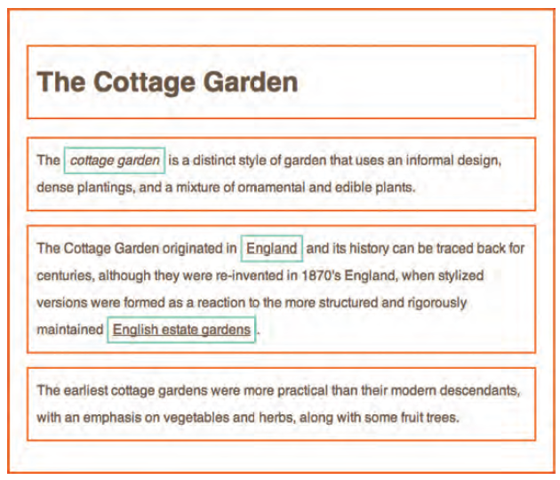
Understanding CSS…
Notes:
5

Slide 6
Examples of Styles
Boxes
  Width and height
  Borders (color, width, and style)
  Background color and images
  Position in the browser window
Text
  Typeface
  Size
  Color
  Italics, bold, uppercase,
  lowercase, small-caps
Specific
  There are also specific ways in which you can style certain elements such as lists, tables, and forms.
..\Examples\thinking-inside-the-box-borderless.html
..\Examples\thinking-inside-the-box.html
Notes:
6

Slide 7
Using External CSS
The <link> element can be used in an HTML document to tell the browser where to find the CSS file used to style the page.
<link> is an empty element (meaning it does not need a closing tag), and it lives inside the <head> element
The <link> element uses three attributes: Text
  href - This specifies the path to the CSS file (which is often placed in a folder called css or styles).
  type - This attribute specifies the type of document being linked to. The value should be text/css.
  rel - This specifies the relationship between the HTML page and the file it is linked to. The value should be stylesheet when linking to a CSS file.
An HTML page can use more than one CSS style sheet. To do this it could have a <link> element for every CSS file it uses.
Example: ..\Examples\using-external-css.html
Notes:
7

Slide 8
Using Internal CSS
You can also include CSS rules within an HTML page by placing them inside a <style> element, which usually sits inside the <head> element of the page.
The <style> element should use the type attribute to indicate that the styles are specified in CSS. The value should be text/css.
When building a site with more than one page, you should use an external CSS style sheet. This:
  Allows all pages to use the same style rules (rather than repeating them in each page).
  Keeps the content separate from how the page looks.
  Means you can change the styles used across all pages by altering just one file (rather than each individual page).
Example: ..\Examples\using-internal-css.html
Notes:
8

Slide 9
CSS Structure
Selector Declaration Block
Declaration Declaration
Property Value Property Value
YOUR CODE:
p {
color: red;
font-size: 1.5em;
}
Note: em is another way of saying font size
p
{ color : red; font-size : 1.5em; }
Notes:
9

Slide 10
Selectors and Declarations
CSS works by associating rules with HTML elements. These rules govern how the content of specified elements should be displayed. A CSS rule contains two parts: a selector and a declaration.
Selectors indicate which element the rule applies to. The same rule can apply to more than one element if you separate the element names with commas.
Declarations indicate how the elements referred to in the selector should be styled. Declarations are split into two parts (a property and a value), and are separated by a colon.
CSS declarations sit inside curly brackets and each is made up of two parts: a property and a value, separated by a colon. You can specify several properties in one declaration, each separated by a semi-colon.
Notes:
10

Slide 11
Selectors
There are many different types of CSS selector that allow you to target rules to specific elements in an HTML document.
The table on the opposite page introduces the most commonly used CSS selectors.
CSS selectors are case sensitive, so they must match element names and attribute values exactly.
Example: ..\Examples\css-selectors.html
Notes:
11

Slide 12
Examples of Selectors
HTML
CSS Selector
<p>
<h1>
<table>
<tr>
<td>
<ul>
<li>
<option>
p {}
h1 {}
table {}
tr {}
td {}
ul {}
li {}
option {}
Notes:
12

Slide 13
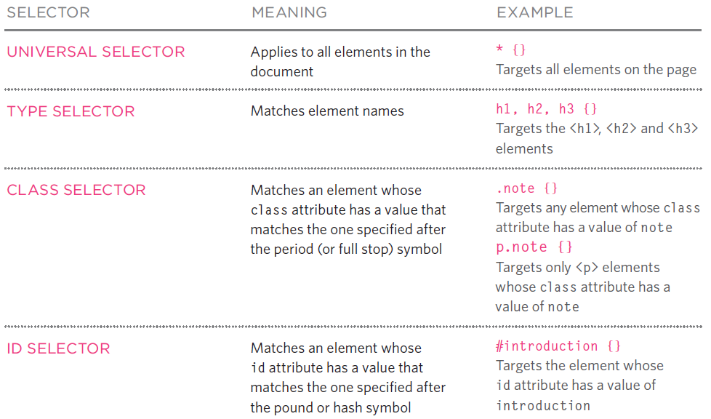
Examples of Selectors
Notes:
13

Slide 14
Grouping Selectors
When several selectors share the same declarations, they may be grouped into a comma-separated list.
can be simplified to:
h1 { font-family: sans-serif }
h2 { font-family: sans-serif }
h3 { font-family: sans-serif }
h1, h2, h3 { font-family: sans-serif }
Notes:
14

Slide 15
Class vs. ID
Most of your HTML tags will now contain either a class or an ID
The id selector is used to specify a style for a single, unique element.
The class selector is used to specify a style for a group of elements.
Unlike the id selector, the class selector is most often used on several elements.
Notes:
15

Slide 16
ID Examples
<p id=“intro”>
#intro {font-family: sans-serif;
font-size: medium;
font-weight: normal; }
The id selector uses the id attribute of the HTML element, and is defined with a "#".
HTML:
CSS:
Notes:
16

Slide 17
Class Example
<p class=“intro”>
.intro {font-family: sans-serif;
font-size: medium;
font-weight: normal; }
The class selector uses the HTML class attribute, and is defined with a "."
HTML:
CSS:
Notes:
17

Slide 18
How CSS Rules Cascade
If there are two or more rules that apply to the same element, it is important to understand which will take precedence.
  LAST RULE - If the two selectors are identical, the latter of the two will take precedence. In the example below you can see the second i selector takes precedence over the first.
  SPECIFICITY - If one selector is more specific than the others, the more specific rule will take precedence over more general ones.
  IMPORTANT - You can add !important after any property value to indicate that it should be considered more important than other rules that apply to the same element.
Understanding how CSS rules cascade means you can write simpler style sheets because you can create generic rules that apply to most elements and then override the properties on individual elements that need to appear differently.
Example: ..\Examples\cascade.html
Notes:
18

Slide 19
Inheritance
If you specify the font-family or color properties on the <body> element, they will apply to most child elements.
This is because the value of the font-family property is inherited by child elements
It saves you from having to apply these properties to as many elements (and results in simpler style sheets)
You can compare this with the background-color or border properties; they are not inherited by child elements
Example: ..\Examples\inheritance.html
Notes:
19

Slide 20
Why use external style sheets
All of your web pages can share the same style sheet
Once the user has downloaded the CSS stylesheet, the rest of the site will load faster.
If you want to make a change to how your site appears, you only need to edit the one CSS file and all of your pages will be updated.
For example, you can change the style of every <h1> element by altering the one CSS style sheet, rather than changing the CSS rules on every page.
It is generally considered good practice to have the content of the site separated from the rules that determine how it appears.
Notes:
20

Slide 21
Web Browsers / CSS
Some browsers display a few of the CSS properties in unexpected ways
Before launching any new site, it is important to test it in more than one browser, because there can be slight differences in how browsers display the pages.
There are online tools to show you what a page looks like in multiple browsers:
  http://browsershots.org/
  http://crossbrowsertesting.com/
Notes:
21

Slide 22
Revisiting the DIV tag
The <div> tag defines a division or a section in an HTML document.
The <div> tag is used to group block-elements to format them with CSS.
Notes:
22

Slide 23
Div – Standard Web Page Example
<div id = “pageheader”>
<div id= “left”>
<div id = “main”>
<div id = “right”>
<div id = “pagefooter”
Notes:
23

Slide 24
The Background
CSS background properties are used to define the background effects of an element.
CSS properties used for background effects:
  background
  background-color
  background-image
  background-repeat
  background-attachment
  background-position
Background can be used on <body>,<div>,<table>, etc
Notes:
24

Slide 25
Background Examples
body {background-color: blue;}
p {background-color: #e0ffff;}
div {background-color: #b0c4de;}
body
{
background-image: url('gradient2.png');
background-repeat: repeat-x;
}
All in one
body
{background: #ffffff url('img_tree.png') no-repeat right top;}
Notes:
25

Slide 26
Summary
CSS treats each HTML element as if it appears inside its own box and uses rules to indicate how that element should look.
Rules are made up of selectors (that specify the elements the rule applies to) and declarations (that indicate what these elements should look like).
Different types of selectors allow you to target your rules at different elements.
Declarations are made up of two parts: the properties of the element that you want to change, and the values of those properties. For example, the font-family property sets the choice of font, and the value arial specifies Arial as the preferred typeface.
CSS rules usually appear in a separate document, although they may appear within an HTML page.
Notes:
26

Slide 27
References
HTML and CSS Design and Build Websites (Jon Duckett)
http://www.w3schools.com
..\Examples\example.html
Notes:
27

